Slide 1
CND212: Digital Testing and Verification

Slide 2
SystemVerilog Assertions
Assertions are primarily used to validate the behaviour of a design.
("Is it working correctly?")
They may also be used to provide functional coverage information for a design. ("How good is the test?")
Assertions can be checked dynamically by simulation, or statically by a separate property checker tool.
There are two types of assertions: immediate (assert) and concurrent (assert property).

Slide 3
Who writes Assertions
Design Engineers
_Capture design assumptions
_Record design intentions and internal error conditions
_Design behavior
Verification Engineers
_Interface, cross-block, higher level behavior
IP Providers

Slide 4

Immediate Assertions
Immediate assertions are procedural statements and are mainly used in simulation.
An assertion is basically a statement that something must be true, similar to the if statement.
If the conditional expression of the immediate assert evaluates to X, Z or 0, then the assertion fails and the simulator writes an error message.

Slide 5
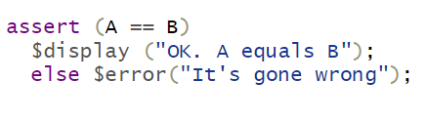
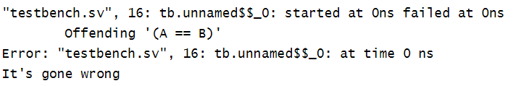
Immediate Assertions
An immediate assertion may include a pass and/or fail statements.
Three severity system tasks can be included in the fail statement to specify a severity level: $error, $fatal, $warning.
In addition, the system task $info indicates that the assertion failure carries no specific severity.
Notes:
Display the automatic message first and then your fail message.

Slide 6
Concurrent Assertions
Concurrent assertions check the sequence of events spread over multiple clock cycles.
SystemVerilog concurrent assertion statements can be specified in a module, interface or program block and running concurrently with other statements.
Concurrent assertions usually appear outside any initial or always blocks in modules, interfaces and programs.
Sampling of variables is done in the proponed region and evaluation of the expression is done in the observed region of the simulation scheduler.
The Keyword “property” differentiates the immediate assertion from the concurrent assertion.

Slide 7
Concurrent Assertions
Property: "A Request should be followed by an Acknowledge occurring no more than two clocks after the Request is asserted.“
Concurrent assertion is only checked when a rising clock edge has occurred; the values of Req and Ack are sampled on the rising edge of the Clock.

Slide 8
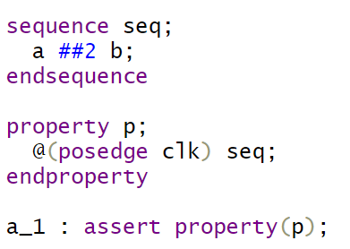
Building blocks of SVA
Create Boolean Expressions
Create Sequence
Create Property
Assert Property
Notes:
Properties are built using sequences.

Slide 9
Implication
The implication construct (|->) allows a user to monitor sequences based on satisfying some criteria.
attach a precondition to a sequence and evaluate the sequence only if the condition is successful.
The left-hand side of the implication is called the “antecedent” and the right-hand side is called the “consequent.”
The antecedent is the gating condition. If the antecedent succeeds, then the consequent is evaluated.
There are 2 types of implication:
Overlapped implication |->
Non-overlapped implication |=>

Slide 10
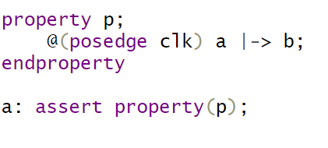
Overlapped implication
The overlapped implication is denoted by the symbol |->.
If there is a match on the antecedent, then the consequent expression is evaluated in the same clock cycle.
The above property checks that, if signal “a” is high on a given positive clock edge, then signal “b” should also be high on the same clock edge.

Slide 11
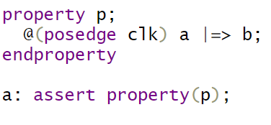
Non-overlapped implication
The non-overlapped implication is denoted by the symbol |=>.
If there is a match on the antecedent, then the consequent expression is evaluated in the next clock cycle.
The above property checks that, if signal “a” is high on a given positive clock edge, then signal “b” should be high on the next clock edge.

Slide 12
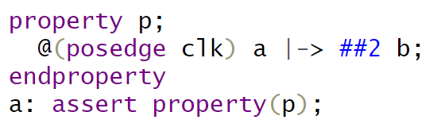
Implication
The implication with a fixed delay on the consequent.
The above property checks that, if signal “a” is high on a given positive clock edge, then signal “b” should be high after 2 clock cycles.

Slide 13
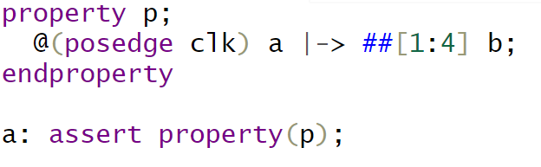
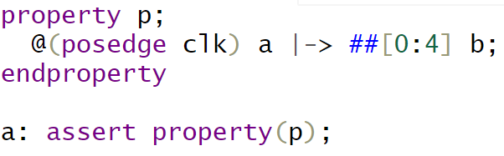
Implication
Below property checks that, if signal “a” is high on a given positive clock edge, then within 1 to 4 clock cycles, the signal “b” should be high.
Below property checks that, if signal “a” is high on a given positive clock edge, then signal “b” should be high in the same clock cycle or within 4 clock cycles.

Slide 14
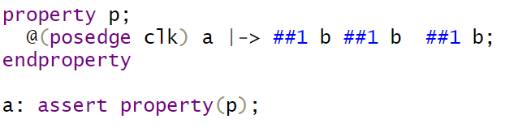
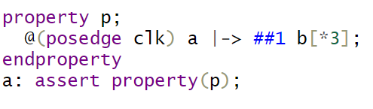
Repetition
The above property checks that, if the signal “a” is high on given posedge of the clock, the signal “b” should be high for 3 consecutive clock cycles.

Slide 15
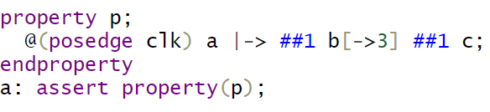
Repetition
The above property checks that, if the signal “a” is high on given posedge of the clock, the signal “b” should be high for 3 clock cycles followed by “c” should be high after ”b” is high for the third time.

Slide 16
Repetition
The above property checks that, if the signal “a” is high on given posedge of the clock, the signal “b” should be high for 3 clock cycles followed by “c” should be high after ”b” is high for the third time.

Slide 17
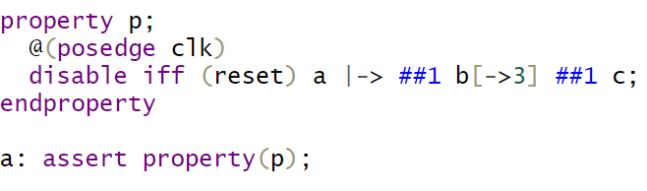
disable iff
In certain design conditions, we don’t want to proceed with the check if some condition is true. this can be achieved by using disable iff.
Below property checks that, if the signal “a” is high on given posedge of the clock, the signal “b” should be high for 3 clock cycles followed by “c” should be high after ”b” is high for the third time. During this entire sequence, if reset is detected high at any point, the checker will stop.

Slide 18
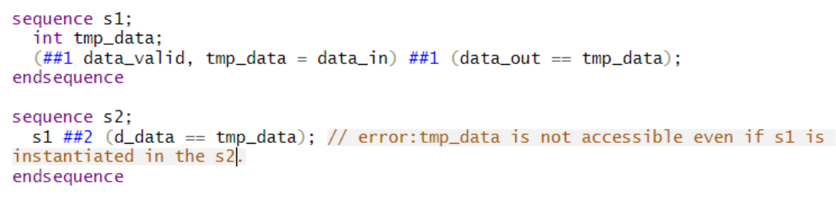
Local variables in A sequence
One of the powerful features of SVA, It enables information to be stored within the thread of a sequence and then tested at later cycles within this sequence. Variables can be used in sequence and property where it’s declared.

Slide 19
SVA Methods
$rose: used to detect the rising edge of a signal. It evaluates to true if the given signal transitions from low to high at the current clock tick.
$fell: the opposite of $rose. It detects the falling edge of a signal. It evaluates to true if the given signal transitions from high to low at the current clock tick.
$stable: returns true if the value of the expression did not change. Otherwise, it returns false.
$changed: the opposite of $stable. It checks if a signal has changed its value between the current and previous clock ticks
$past: The $past function is used to access the value of an expression in the previous clock tick.

Slide 20
Lab task

Slide 21
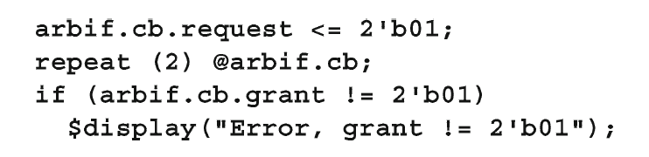
Lab Task
Use your lab 5 files “arbiter.v”, “arbiter_io.sv”, “test.v”, and “arbiter_test_top.sv”
In the testbench (test.v), consider you want to check the grant signal is correct when a certain request is sent like shown in the example below.
Replace the if statement above with an immediate assertion
2) Add a concurrent assertion in your interface (arbiter_io.sv) that checks that the arbiter request signal does not have X or Z values except during reset.

Slide 22
Assignment : (~60 mins)

Slide 23
Assignment
1. Write a SystemVerilog assertion to check if a signal valid is high whenever a signal ready is high
2. Write a SystemVerilog assertion to check if a sequence of events a, b, and c occurs in the given order with a onecycle gap between each event. Ensure that the sequence does not trigger if the reset signal is active.
3. Write a SystemVerilog cover directive to measure the coverage of a signal data being greater than zero.
4. Write a SystemVerilog sequence that checks if a signal a is high for at least two clock cycles, followed by a sequence of events b and c, and assert it.
5. Write a SystemVerilog sequence, s1, that checks for the following pattern in a signal sequence:
_The sequence should start with a rising edge of a signal called data_valid.
_The sequence should then wait for a delay of 7 clock cycles.
_After the delay, the signal data_out should be equal to the value stored in data_in before the delay.

Slide 24
Assignment
6. Consider the following SystemVerilog sequence: S1 ##2 S2[=1:2] ##1 S3 ##1 S4[->1:3] ##1 S5.
Your task is to analyze the given sequence and identify the conditions that will result in the sequence succeeding or failing.
Write a comprehensive explanation that includes:
_The conditions under which the sequence will succeed.
_The conditions that will cause the sequence to fail.
_Provide specific examples for both success and failure cases to demonstrate your understanding.

